Slide 1
Time Complexities of Three Sorting Algorithms
CPS 3440 workshop 1

Slide 2
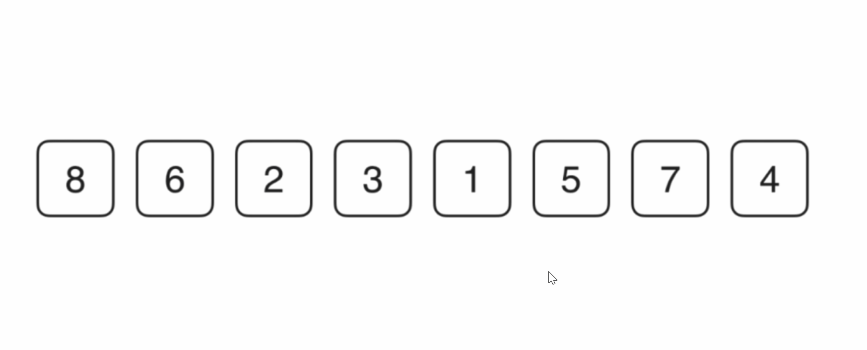
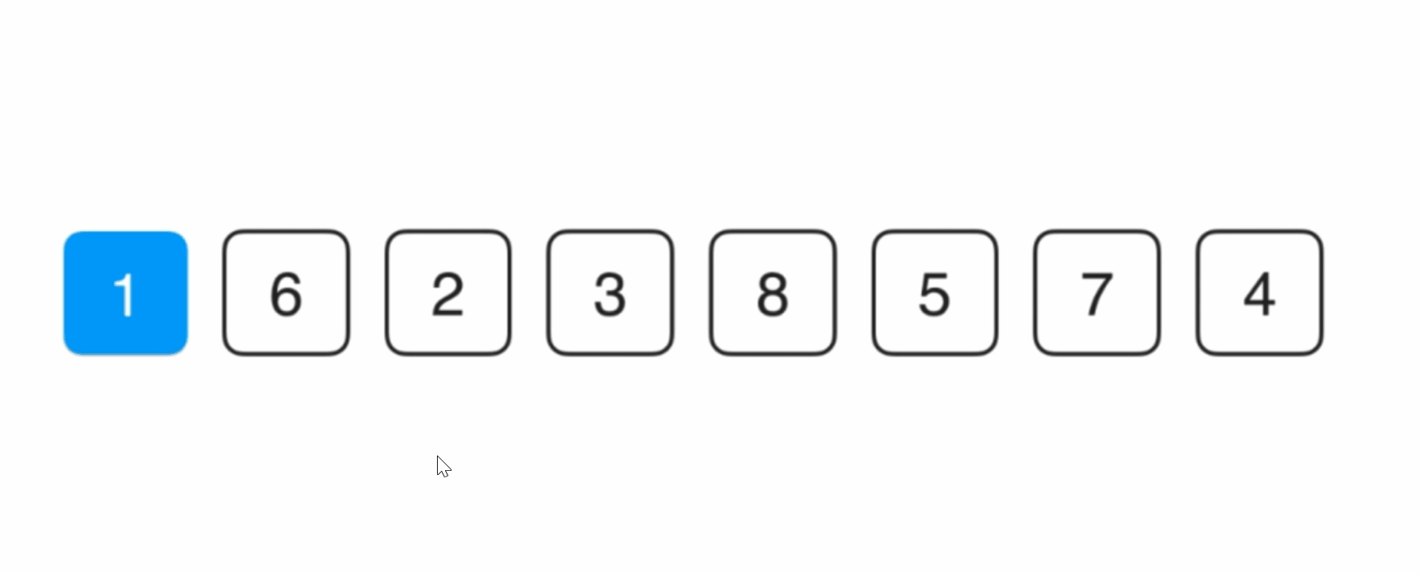
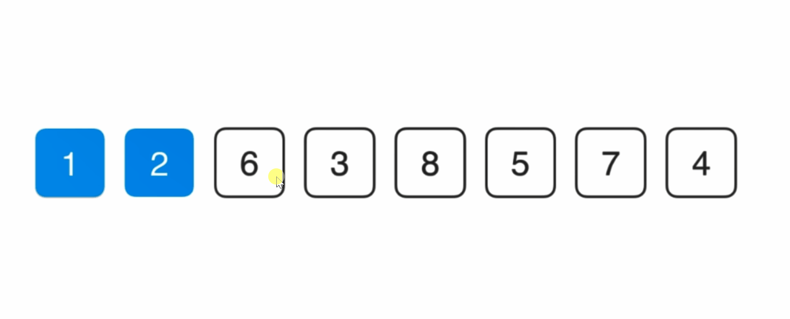
Selection Sort
First, select the smallest element
Then, select the smallest element among the remaining elements
Then, select the smallest element among the remaining elements
··· ···
Select the smallest element among elements that have not yet been processed every time.

Slide 3
public class SelectionSort{ // Our algorithm class does not allow any instances private SelectionSort(){} public static void sort(Comparable[] arr){ int n = arr.length; for( int i = 0 ; i < n ; i ++ ){ // Find the index of the smallest value in the interval [i, n) int minIndex = i; for( int j = i + 1 ; j < n ; j ++ ) // Use compareTo method to compare the size of two Comparable objects if( arr[j].compareTo( arr[minIndex] ) < 0 ) minIndex = j; swap( arr , i , minIndex); } } private static void swap(Object[] arr, int i, int j) { Object t = arr[i]; arr[i] = arr[j]; arr[j] = t; } }
Sorted: arr[0, i)
Out of order: arr[i, 0)

Slide 4
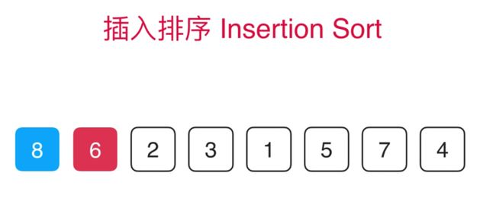
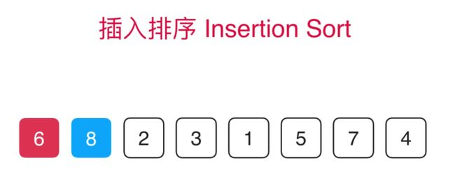
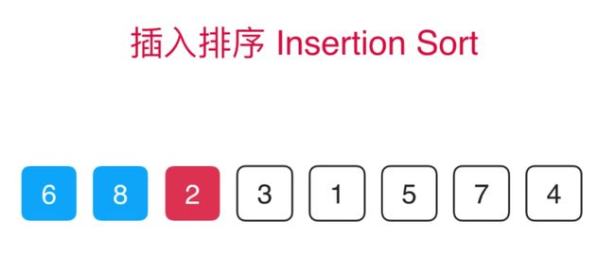

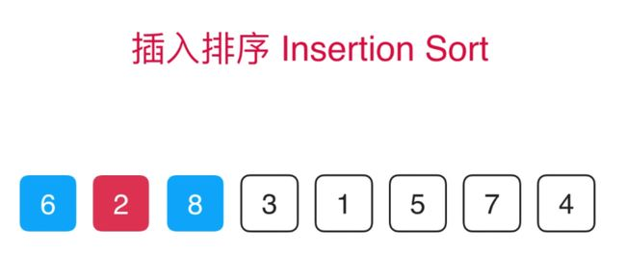
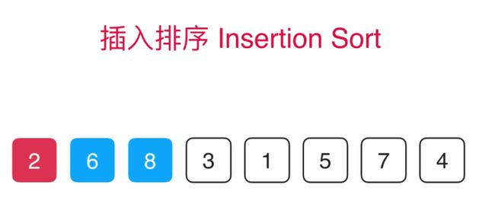
Insertion Sort
Sorted: arr[0, i)
Out of order: arr[i, 0)
··· ···

Slide 5
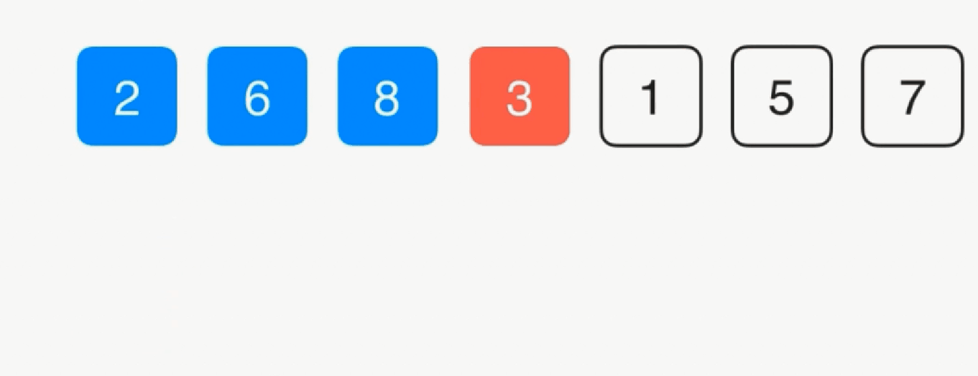
public class InsertionSort{ // Our algorithm class does not allow any instances private InsertionSort(){} // Use InsertionSort to sort the entire arr array public static void sort(Comparable[] arr){ int n = arr.length; for (int i = 0; i < n; i++) { Comparable e = arr[i]; int j = i; for( ; j > 0 && arr[j-1].compareTo(e) > 0 ; j--){
arr[j] = arr[j-1];
}
arr[j] = e; } }
1. simplify
2. optimization

Slide 6
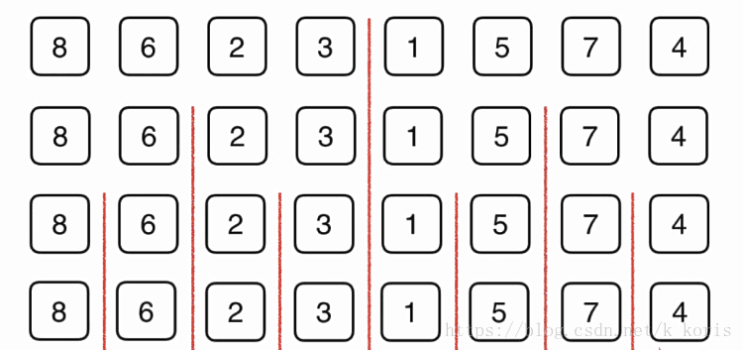
Merge Sort
In mergeSort(E[] arr, l, r):
Step 1: Sort arr[l, mid]
Step 2: Sort arr[mid+1, r]
Step 3: Merge sorted arr[l, mid] and arr[mid+1, r]

Slide 7
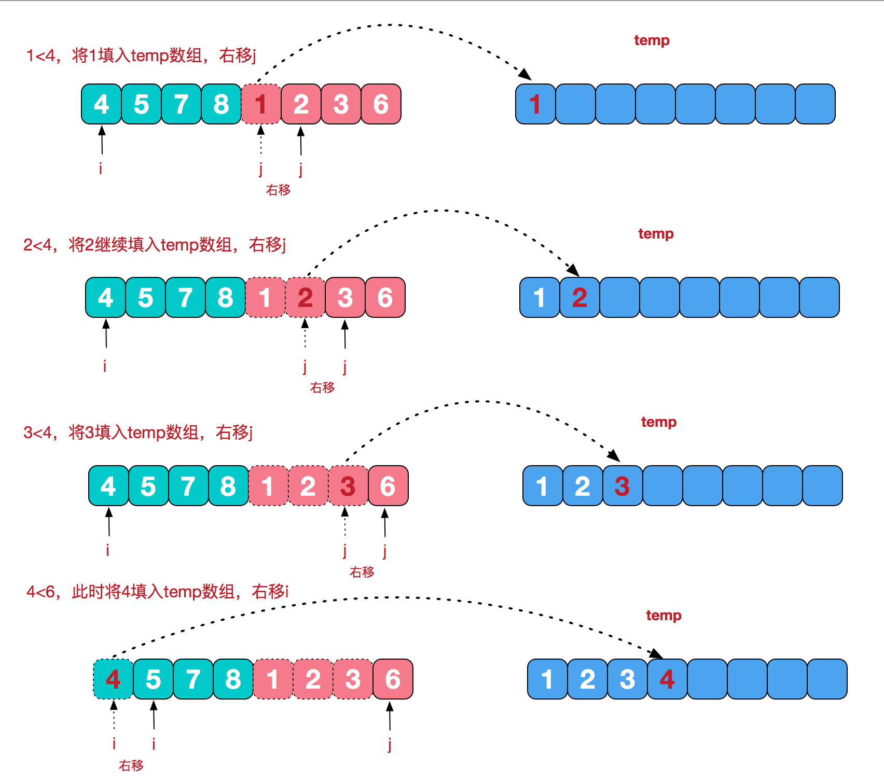

Slide 8
// Combine the two parts of arr[l...mid] and arr[mid+1...r] private static void merge(Comparable[] arr, int l, int mid, int r) { Comparable[] aux = Arrays.copyOfRange(arr, l, r+1); // Initialization, i points to the left half of the starting index position l; j points to the right half of the starting index position mid+1 int i = l, j = mid+1; for( int k = l ; k <= r; k ++ ){ if( i > mid ){ // If the left half of the elements have all been processed arr[k] = aux[j-l]; j ++; } else if( j > r ){ // If the right half of the elements have all been processed arr[k] = aux[i-l]; i ++; } else if( aux[i-l].compareTo(aux[j-l]) < 0 ){ // The element pointed to by the left half <the element pointed by the right half arr[k] = aux[i-l]; i ++; } else{ // The element referred to in the left half >= the element referred to in the right half arr[k] = aux[j-l]; j ++; } } }

Slide 9
private static void sort(Comparable[] arr, int l, int r) { // Optimization 2: For small-scale arrays, use insertion sort if( r - l <= 15 ){ InsertionSort.sort(arr, l, r); return; } int mid = (l+r)/2; sort(arr, l, mid); sort(arr, mid + 1, r); // Optimization 1: For the case of arr[mid] <= arr[mid+1], do not merge // It is very effective for nearly ordered arrays, but for general cases, there is a certain performance loss if( arr[mid].compareTo(arr[mid+1]) > 0 ) merge(arr, l, mid, r); } public static void sort(Comparable[] arr){ int n = arr.length; sort(arr, 0, n-1); }
Optimization 1: Best case: O(n)!!!

Slide 10
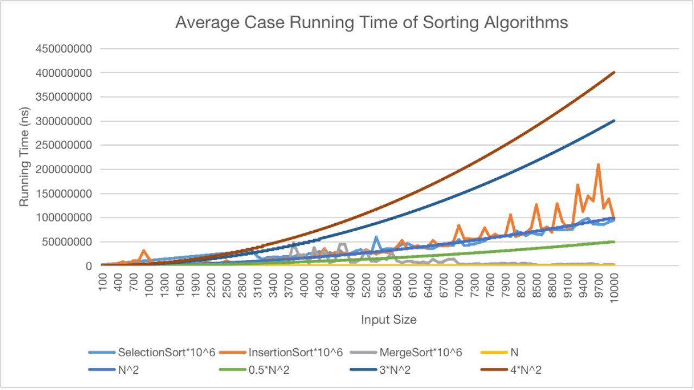

Slide 11
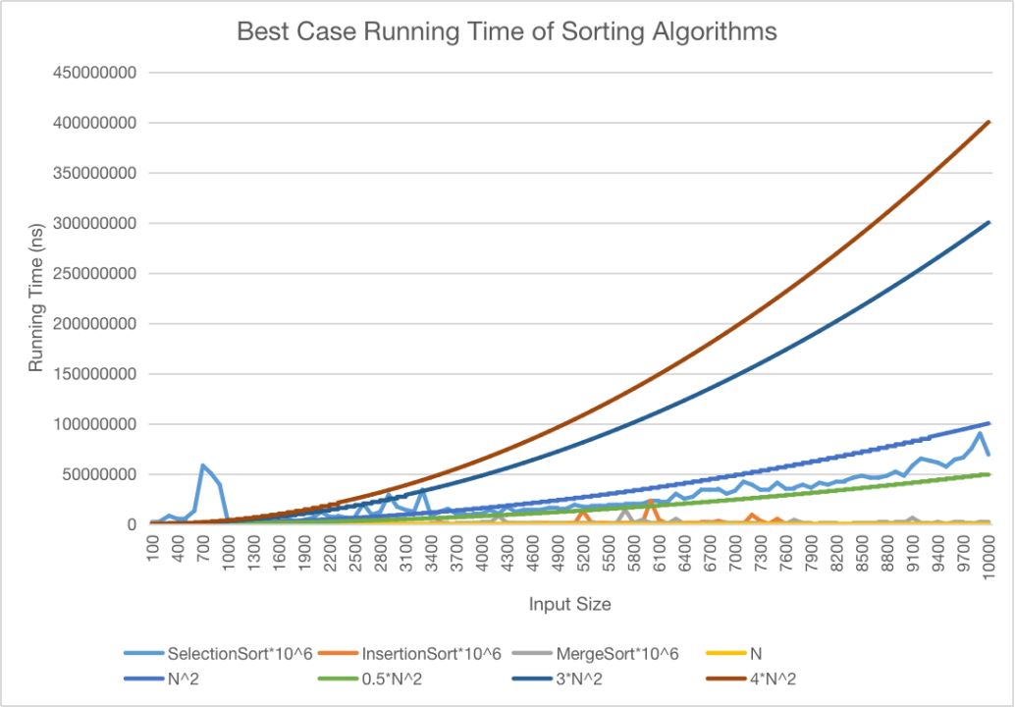

Slide 12


Slide 13
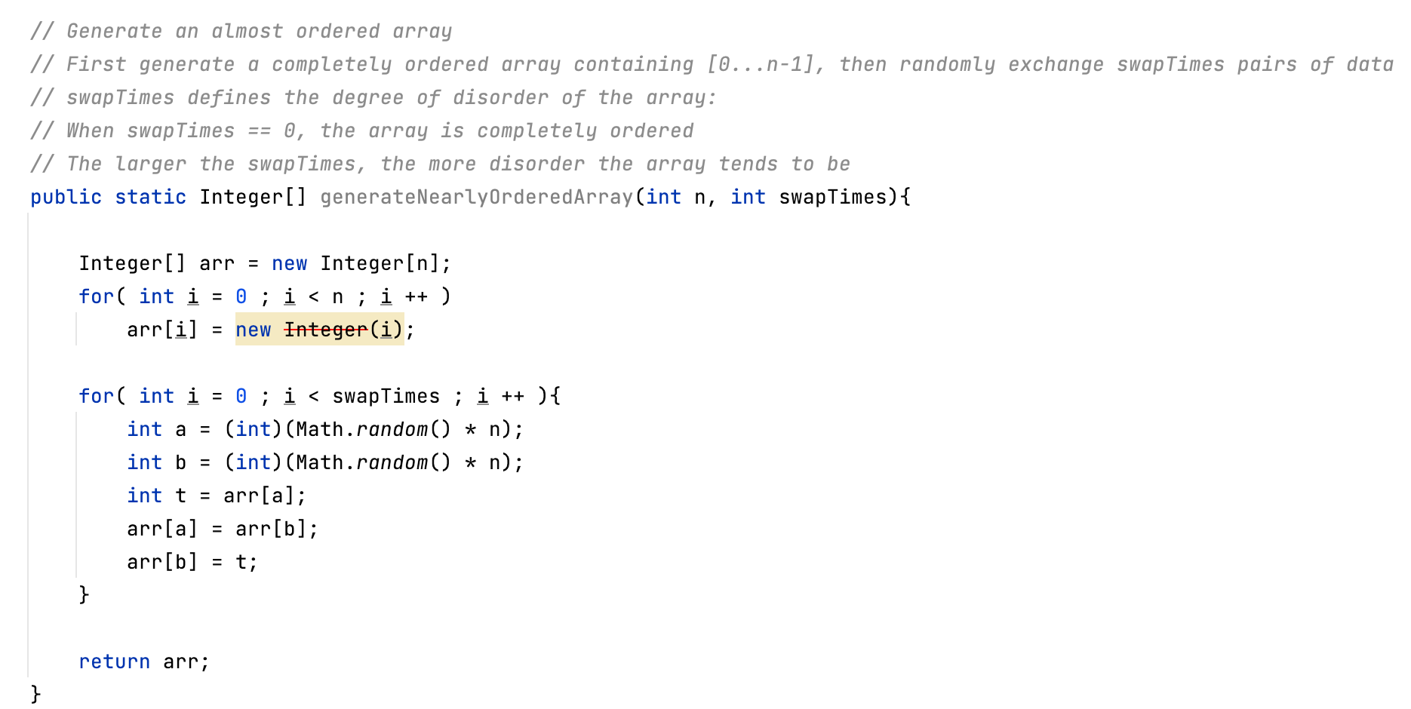

Slide 14
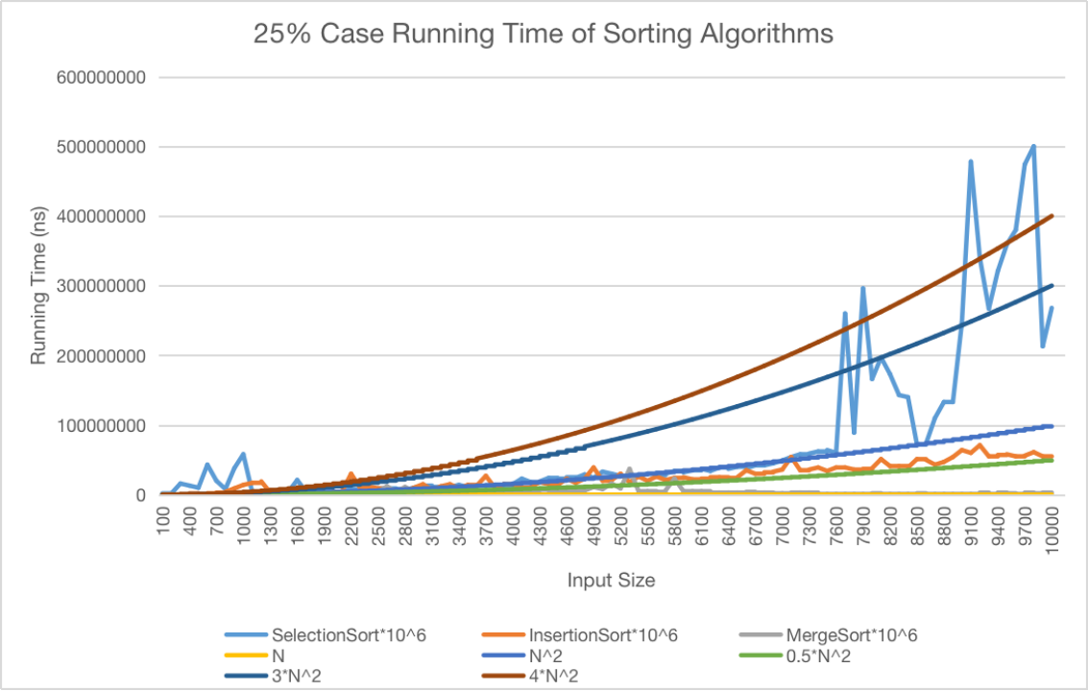

Slide 15
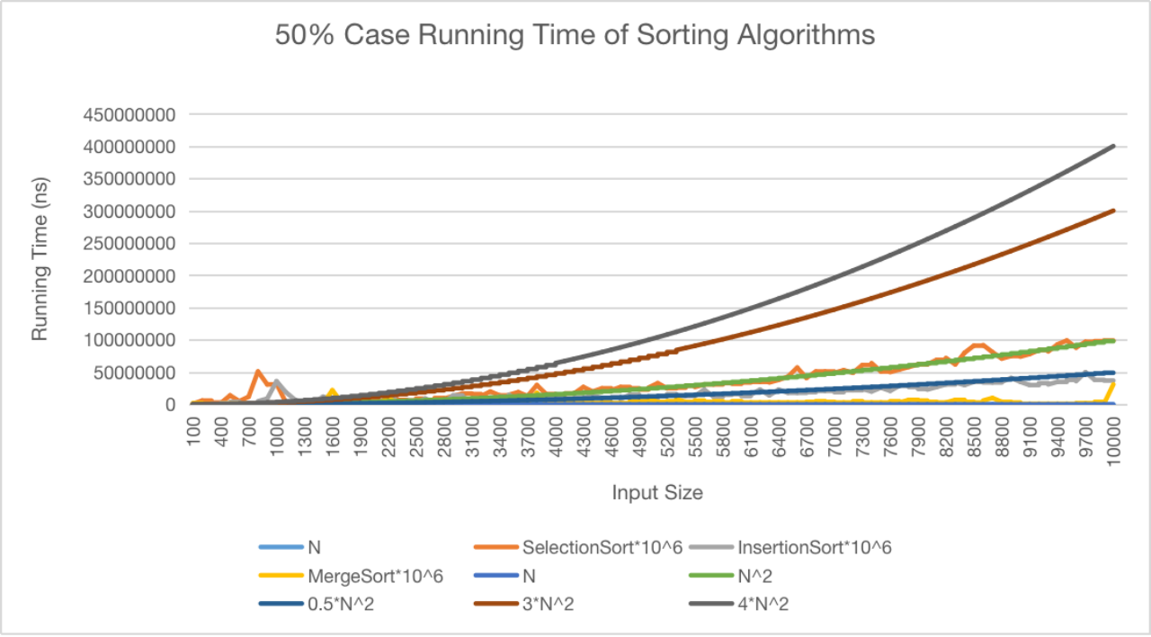

Slide 16
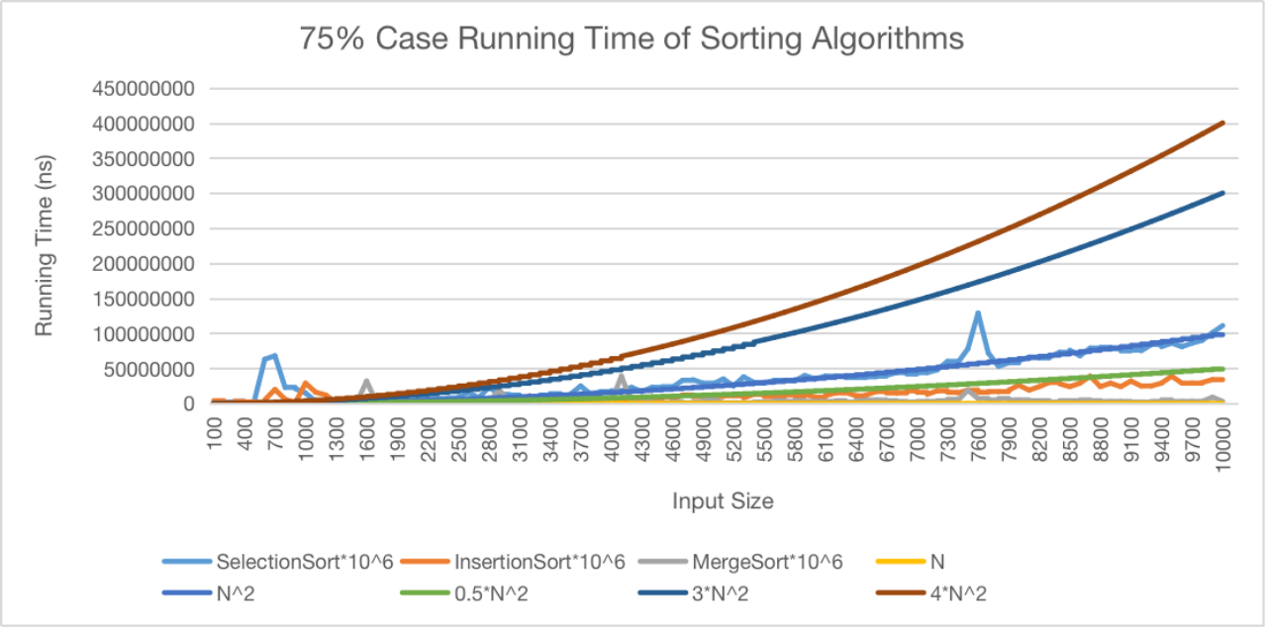

Slide 17
Questions?

Slide 18
Thanks！

